Slide 1

Bot Design
Practices
and Methods
Nigel T. Crowther
EMEA Tech Sales

Slide 2




Bot Design
Bot Design
Design before Build
Knowledge base
Implementation patterns
+
+
Design before coding
Use the knowledge
Patterns make perfect
For complex bots use a design
Designs help the business understand what the bot will do, and help you explain it to the business!
Search the RPA library
Read the script development guidelines: https://www.ibm.com/docs/en/rpa/21.0?topic=development-script-guidelines
Apply common patterns to make your bot robust and ready for production
Re-use bot code
IBM Automation / © 2021 IBM Corporation
2
Notes:
IBM, it’s clients and many industry participants see a clear path towards resiliency that leverages the most efficient and effective technologies for more agile, adaptive and resilient processes.
Automation enables customers to digitize their operations with low-code, cloud-ready containerized automation software.
Next, Automation applies AI in practical ways so you don’t need a data scientist. Things like, Document Understanding, Next Best Tasks. These build on your existing Digitization efforts with Cloud Pak for Automation.
Now you can offload work with our Digital Workers. Digital Workers without AI is just simple RPA/task automation.
We are in a crisis now but these are the things to do for long-term success, as well.

Slide 3
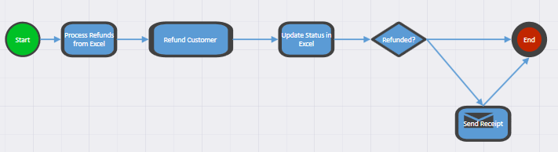
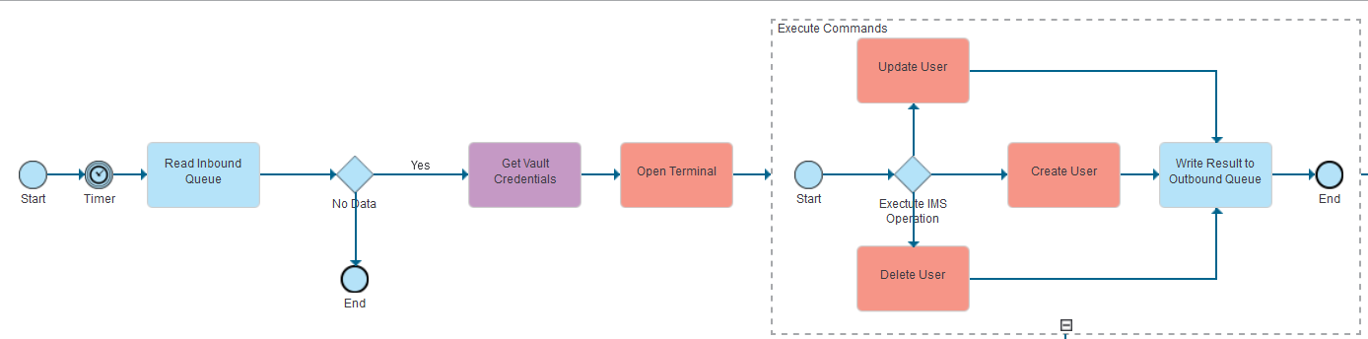
Design
IBM RPA Workflow
Start with a Design
Communicate the design to stakeholders to make sure they understand and you understood!
Convert the design to a working bot framework
Blueworks Live
https://www.ibm.com/uk-en/products/blueworkslive
3
IBM Automation / © 2022 IBM Corporation
3
Notes:
IBM, it’s clients and many industry participants see a clear path towards resiliency that leverages the most efficient and effective technologies for more agile, adaptive and resilient processes.
Automation enables customers to digitize their operations with low-code, cloud-ready containerized automation software.
Next, Automation applies AI in practical ways so you don’t need a data scientist. Things like, Document Understanding, Next Best Tasks. These build on your existing Digitization efforts with Cloud Pak for Automation.
Now you can offload work with our Digital Workers. Digital Workers without AI is just simple RPA/task automation.
We are in a crisis now but these are the things to do for long-term success, as well.

Slide 4
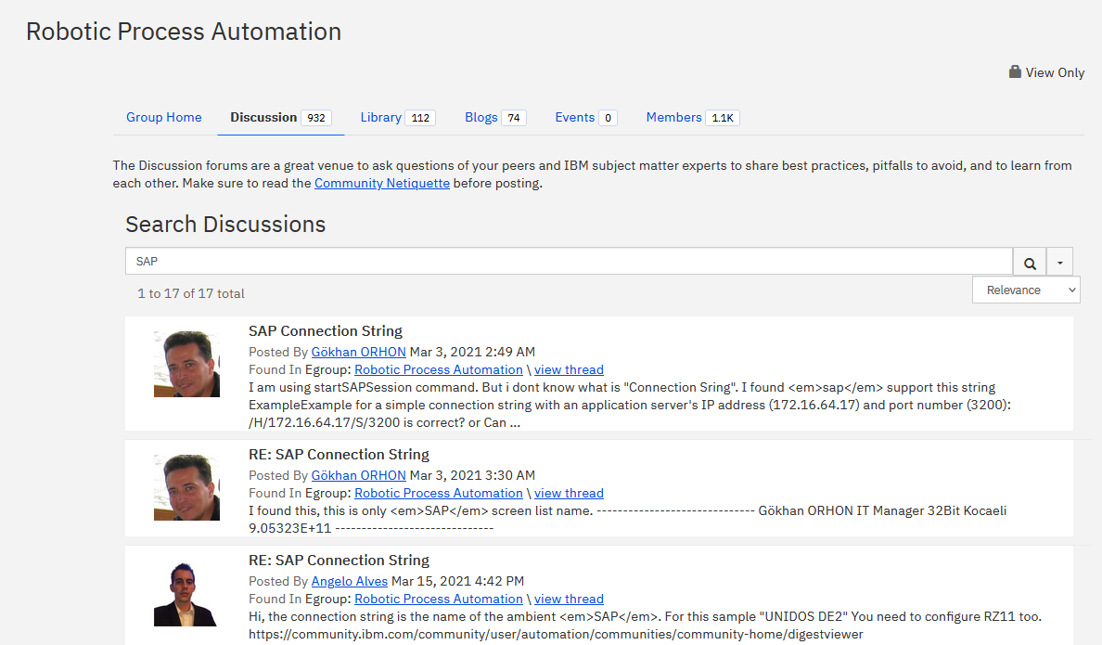
From: XXXXXXXXX Sent: 14 January 2022 17:54 To: 'Nigel Crowther1' <ncrowther@uk.ibm.com> Cc: xxx<ixxx@xxx.gov.uk>; xxx<xxx@xxx.gov.uk> Subject: RE: Automation CoE Operations and Maintenance
Hi Nigel,
Here’s the list of topics we’d appreciate your help with;
1. Tenant related standard issues
2. RPA studio standard issue
3. Standard issues with Launcher
4. Certificate installation related issues
5. Version upgrade related issue (tenant, launcher and studio)
6. Application or Process related issues like timeout, communication errors between tenant and agent/launcher
7. Infra related issues like ports are not working or not open or not available
8. Internet/intranet connectivity issue
9. Unexpected pop-up/security alerts encountered during bot run time,
10. Common errors with the RPA studio/scripts
11. Connectivity issue with virtual machine
12. Max retry of 5 exceeded in,00:00:00 issue in launcher and studio- connectivity issue
13. Bot licence/file related issues
14. Tips on SAP usage with RPA
I know there are quite a few there and that it’d take some time to cover them all so if you know there’s an existing document that covers one or more of the topics in sufficient detail, please could you send us the link to it so we can review it and reference it in our support guide (rather than you creating something from scratch)?
If you’re happy to do so, please share the guides with us as you create them as we know things like support documents are incremental/living documents and are therefore regularly updated.
Finally, if you have any questions or concerns, please let us know.
Many thanks in advance
Search the RPA Forum
Use the IBM RPA Forum
as your COE
Seek and you will find
Don’t reinvent the wheel.
Plagiarize!
IBM Automation / © 2022 IBM Corporation
4
Notes:
IBM, it’s clients and many industry participants see a clear path towards resiliency that leverages the most efficient and effective technologies for more agile, adaptive and resilient processes.
Automation enables customers to digitize their operations with low-code, cloud-ready containerized automation software.
Next, Automation applies AI in practical ways so you don’t need a data scientist. Things like, Document Understanding, Next Best Tasks. These build on your existing Digitization efforts with Cloud Pak for Automation.
Now you can offload work with our Digital Workers. Digital Workers without AI is just simple RPA/task automation.
We are in a crisis now but these are the things to do for long-term success, as well.

Slide 5
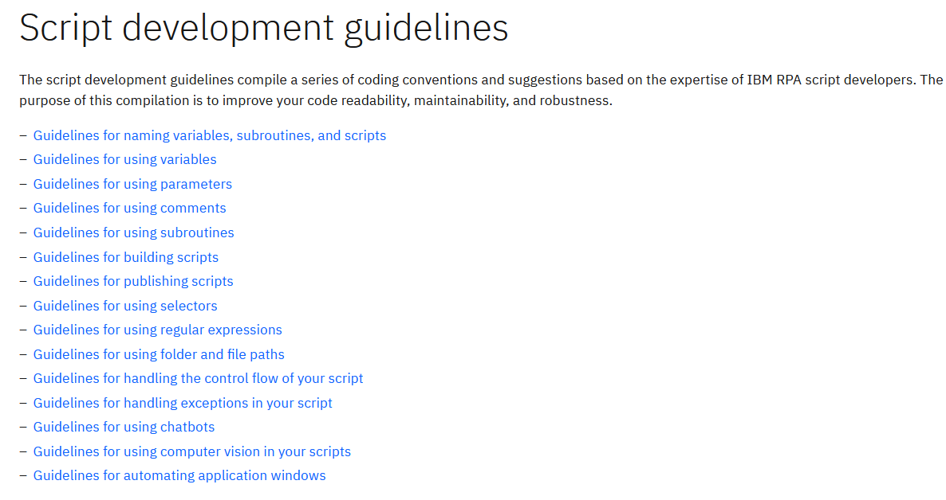
Script
Development Guidelines
https://www.ibm.com/docs/en/rpa/21.0?topic=development-script-guidelines
IBM Automation / © 2022 IBM Corporation
5
Notes:
IBM, it’s clients and many industry participants see a clear path towards resiliency that leverages the most efficient and effective technologies for more agile, adaptive and resilient processes.
Automation enables customers to digitize their operations with low-code, cloud-ready containerized automation software.
Next, Automation applies AI in practical ways so you don’t need a data scientist. Things like, Document Understanding, Next Best Tasks. These build on your existing Digitization efforts with Cloud Pak for Automation.
Now you can offload work with our Digital Workers. Digital Workers without AI is just simple RPA/task automation.
We are in a crisis now but these are the things to do for long-term success, as well.

Slide 6
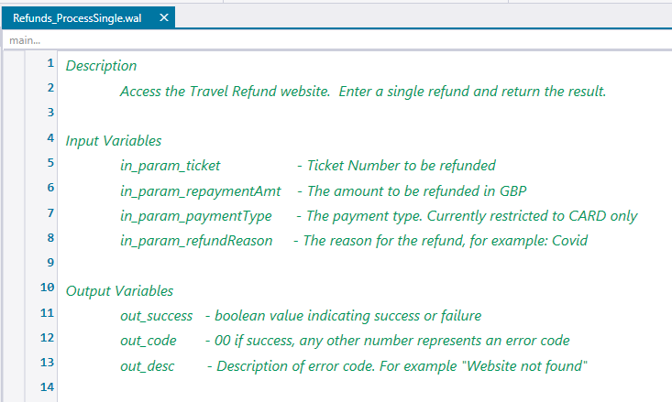
Document complex logic with line comments
Document commands that are not obvious
Include a header in your script
Include a header in your script:
Comments
Comment on complex logic
Comment commands that are not obvious
IBM Automation / © 2022 IBM Corporation
6
Notes:
IBM, it’s clients and many industry participants see a clear path towards resiliency that leverages the most efficient and effective technologies for more agile, adaptive and resilient processes.
Automation enables customers to digitize their operations with low-code, cloud-ready containerized automation software.
Next, Automation applies AI in practical ways so you don’t need a data scientist. Things like, Document Understanding, Next Best Tasks. These build on your existing Digitization efforts with Cloud Pak for Automation.
Now you can offload work with our Digital Workers. Digital Workers without AI is just simple RPA/task automation.
We are in a crisis now but these are the things to do for long-term success, as well.

Slide 7
Use pronounceable names
Good: copyClientDir
Bad: cpCltDir
Naming convention:
Variables should be Camel Case starting with a lowercase letter as in excelRow.
Constant names should be capitalized separating words with an underscore as in MAX_ROWS.
Subroutine names should be Camel Case starting with a capital letter as in GetFile.
Use names that clearly express the subroutine or the script's purpose and action. Good: SendErrorEmail
Variable and subroutine Naming
IBM Automation / © 2022 IBM Corporation
7
Notes:
IBM, it’s clients and many industry participants see a clear path towards resiliency that leverages the most efficient and effective technologies for more agile, adaptive and resilient processes.
Automation enables customers to digitize their operations with low-code, cloud-ready containerized automation software.
Next, Automation applies AI in practical ways so you don’t need a data scientist. Things like, Document Understanding, Next Best Tasks. These build on your existing Digitization efforts with Cloud Pak for Automation.
Now you can offload work with our Digital Workers. Digital Workers without AI is just simple RPA/task automation.
We are in a crisis now but these are the things to do for long-term success, as well.

Slide 8
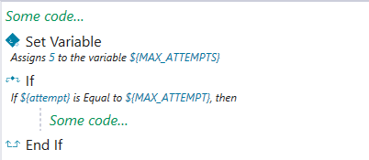
Variable usage
Assign variables above the line where you will use it.
Use constants not magic numbers:
Always remove unused variables
IBM Automation / © 2022 IBM Corporation
8
Notes:
IBM, it’s clients and many industry participants see a clear path towards resiliency that leverages the most efficient and effective technologies for more agile, adaptive and resilient processes.
Automation enables customers to digitize their operations with low-code, cloud-ready containerized automation software.
Next, Automation applies AI in practical ways so you don’t need a data scientist. Things like, Document Understanding, Next Best Tasks. These build on your existing Digitization efforts with Cloud Pak for Automation.
Now you can offload work with our Digital Workers. Digital Workers without AI is just simple RPA/task automation.
We are in a crisis now but these are the things to do for long-term success, as well.

Slide 9
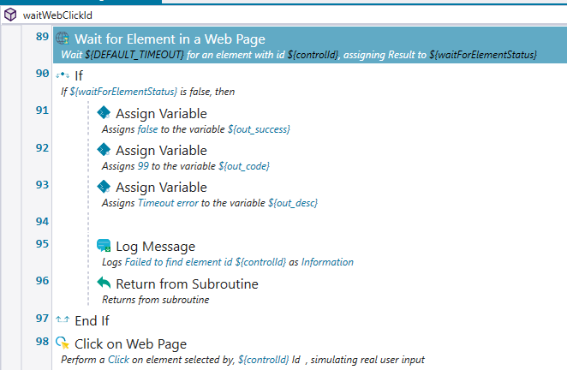
Guidelines for using selectors
Selectors are mechanisms to identify graphical user interface (GUI) controls such as windows, combination boxes, and push buttons. Controls are also called elements.
You should always try to use selectors that identifies only one element in the GUI. Those selectors are called unique selectors.
Identifiers (IDs) are the first options since they are usually unique. However, uniqueness can also depend on the context. Using a CSS selector that references a tag usually does not return single elements
Don't use dynamic IDs
Some applications rely on frameworks that can create IDs automatically. This automatic build can generate IDs automatically during the application's runtime, making those IDs unsuitable for automation.
You can try to identify dynamic IDs by checking their values, since they usually contain:
Example: div:container:form:12
Store selectors in variables if you use them multiple times
Selectors identify user interface controls
Use selectors that identify one element in the GUI. Identifiers (IDs) are preferred since they are usually unique.
Using a CSS selector may not return single elements
Don't use dynamic IDs. Example: div:container:form:12
Use Wait for Element, not Delay:
Web Selectors
IBM Automation / © 2022 IBM Corporation
9
Notes:
IBM, it’s clients and many industry participants see a clear path towards resiliency that leverages the most efficient and effective technologies for more agile, adaptive and resilient processes.
Automation enables customers to digitize their operations with low-code, cloud-ready containerized automation software.
Next, Automation applies AI in practical ways so you don’t need a data scientist. Things like, Document Understanding, Next Best Tasks. These build on your existing Digitization efforts with Cloud Pak for Automation.
Now you can offload work with our Digital Workers. Digital Workers without AI is just simple RPA/task automation.
We are in a crisis now but these are the things to do for long-term success, as well.

Slide 10
Do not ignore exceptions. Ignoring exceptions leads to unexpected behaviour
Use the appropriate log message – Info/Warn/Error
Collect information on the error. The information used for diagnosis
Avoid sending technical messages to end-users.
Recover and retry non-fatal errors
Exception
Handling
IBM Automation / © 2022 IBM Corporation
10
Notes:
IBM, it’s clients and many industry participants see a clear path towards resiliency that leverages the most efficient and effective technologies for more agile, adaptive and resilient processes.
Automation enables customers to digitize their operations with low-code, cloud-ready containerized automation software.
Next, Automation applies AI in practical ways so you don’t need a data scientist. Things like, Document Understanding, Next Best Tasks. These build on your existing Digitization efforts with Cloud Pak for Automation.
Now you can offload work with our Digital Workers. Digital Workers without AI is just simple RPA/task automation.
We are in a crisis now but these are the things to do for long-term success, as well.

Slide 11

Refund Bot - input
https://focuscorpgui.eu-gb.mybluemix.net/
IBM Automation / © 2022 IBM Corporation
11
Notes:
IBM, it’s clients and many industry participants see a clear path towards resiliency that leverages the most efficient and effective technologies for more agile, adaptive and resilient processes.
Automation enables customers to digitize their operations with low-code, cloud-ready containerized automation software.
Next, Automation applies AI in practical ways so you don’t need a data scientist. Things like, Document Understanding, Next Best Tasks. These build on your existing Digitization efforts with Cloud Pak for Automation.
Now you can offload work with our Digital Workers. Digital Workers without AI is just simple RPA/task automation.
We are in a crisis now but these are the things to do for long-term success, as well.

Slide 12
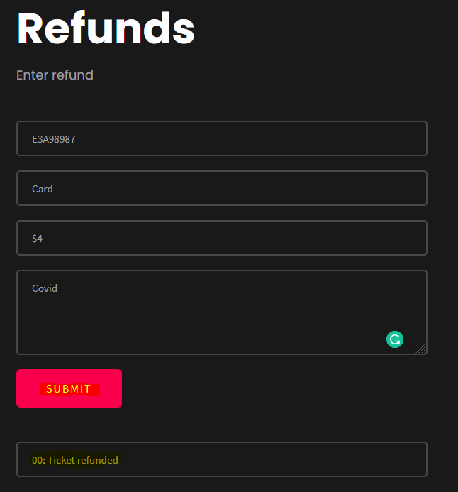
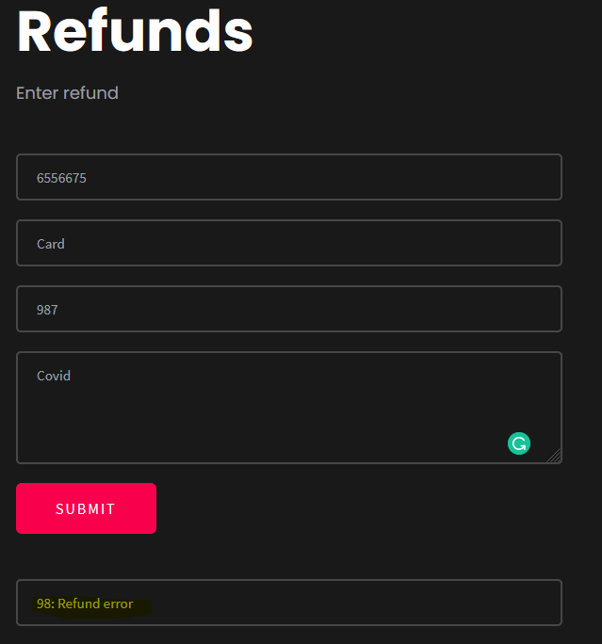
Refund Bot – Error retry handling
IBM Automation / © 2022 IBM Corporation
12
Notes:
IBM, it’s clients and many industry participants see a clear path towards resiliency that leverages the most efficient and effective technologies for more agile, adaptive and resilient processes.
Automation enables customers to digitize their operations with low-code, cloud-ready containerized automation software.
Next, Automation applies AI in practical ways so you don’t need a data scientist. Things like, Document Understanding, Next Best Tasks. These build on your existing Digitization efforts with Cloud Pak for Automation.
Now you can offload work with our Digital Workers. Digital Workers without AI is just simple RPA/task automation.
We are in a crisis now but these are the things to do for long-term success, as well.

Slide 13
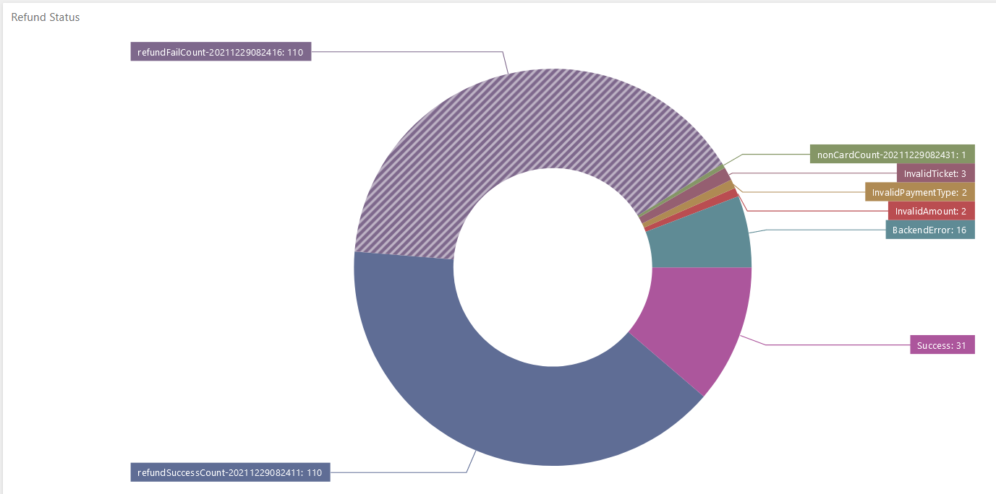
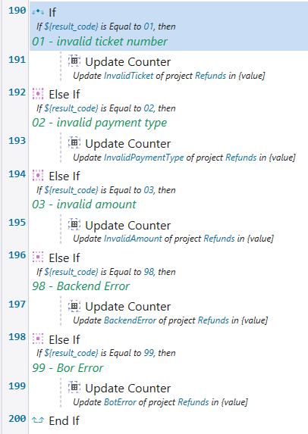
Use Dashboard counters to view real time state of your bot
Dashboard Counters
IBM Automation / © 2022 IBM Corporation
13
Notes:
IBM, it’s clients and many industry participants see a clear path towards resiliency that leverages the most efficient and effective technologies for more agile, adaptive and resilient processes.
Automation enables customers to digitize their operations with low-code, cloud-ready containerized automation software.
Next, Automation applies AI in practical ways so you don’t need a data scientist. Things like, Document Understanding, Next Best Tasks. These build on your existing Digitization efforts with Cloud Pak for Automation.
Now you can offload work with our Digital Workers. Digital Workers without AI is just simple RPA/task automation.
We are in a crisis now but these are the things to do for long-term success, as well.

Slide 14
Lab 1
Bot Design

Slide 15
Refund Bot

Slide 17
Bot Design
IBM Automation / © 2022 IBM Corporation
17
Notes:
IBM, it’s clients and many industry participants see a clear path towards resiliency that leverages the most efficient and effective technologies for more agile, adaptive and resilient processes.
Automation enables customers to digitize their operations with low-code, cloud-ready containerized automation software.
Next, Automation applies AI in practical ways so you don’t need a data scientist. Things like, Document Understanding, Next Best Tasks. These build on your existing Digitization efforts with Cloud Pak for Automation.
Now you can offload work with our Digital Workers. Digital Workers without AI is just simple RPA/task automation.
We are in a crisis now but these are the things to do for long-term success, as well.

